Slide 1
















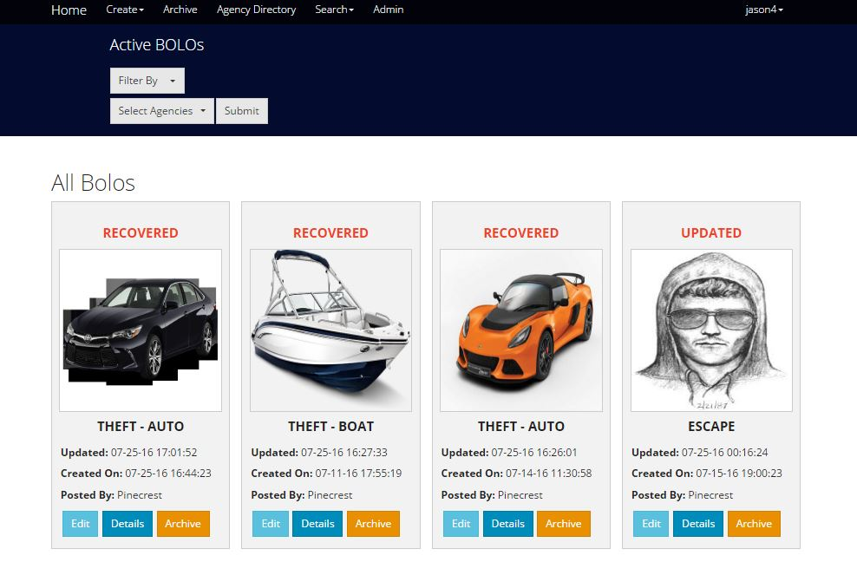
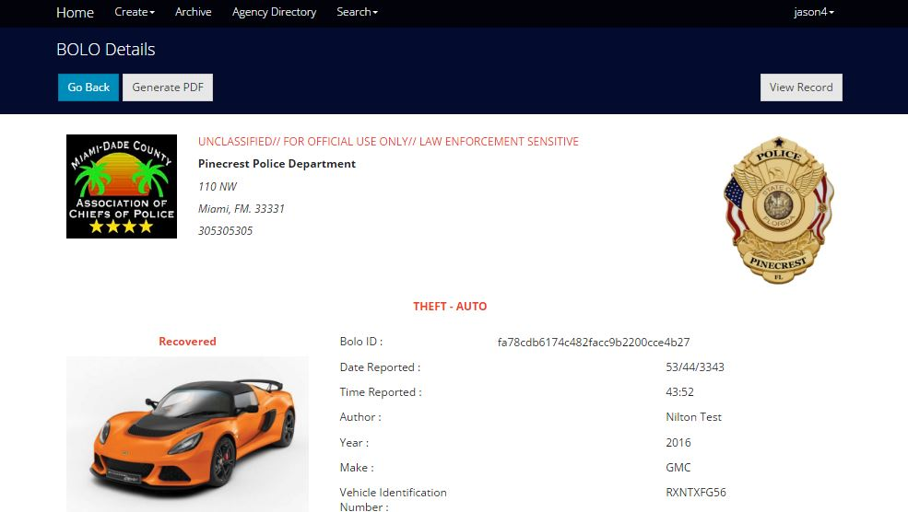
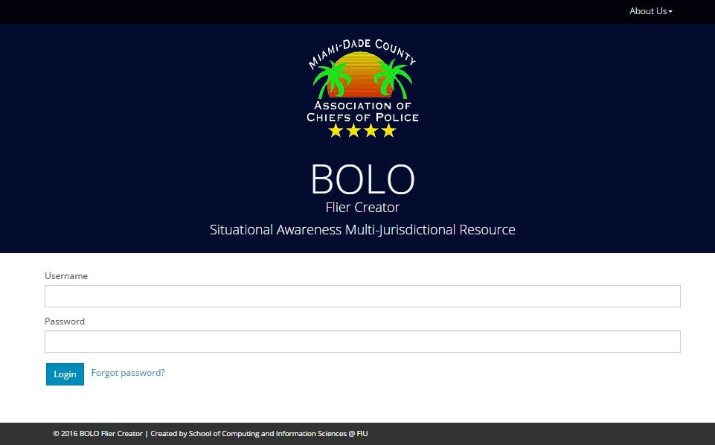

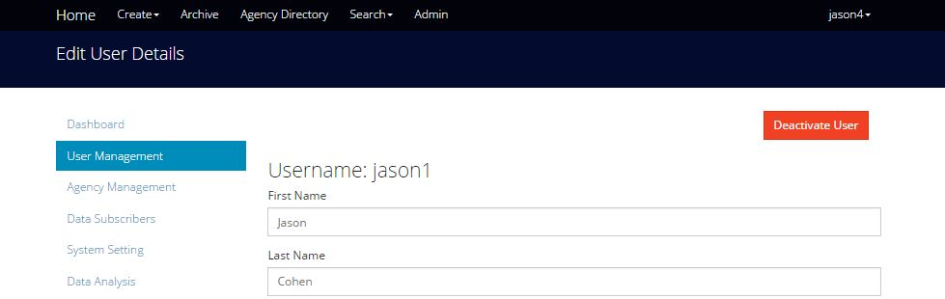
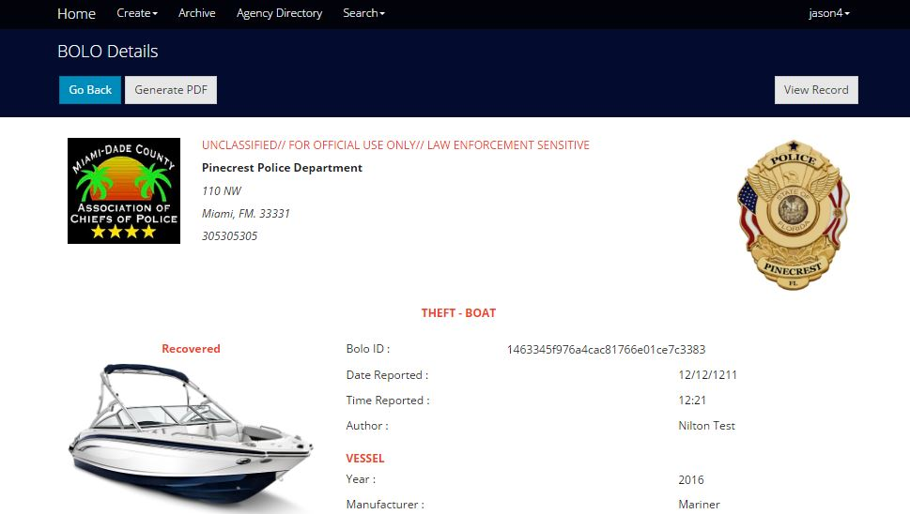
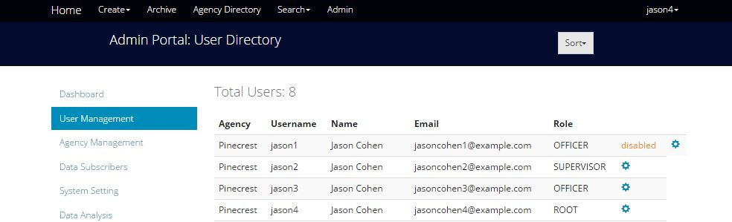

School of Computing & Information Sciences
Senior Project, 2016, Summer
BOLO Flier Creator - Version 5.0
Student: Nilton Munoz, Florida International University
Mentor: Juan Caraballo, IBM; Robert Loredo, IBM
Instructor: Masoud Sadjadi, Florida International University
PROBLEM
CURRENT SYSTEM
REQUIREMENTS
The actual creation of “Be On the Look Out” (BOLO) flyers and its distribution can take up to 24-48 hours. This is only for a single department and their officers. That window of time could be used by criminals to move on to a different location and continue with their crimes. They need a reliable and fast system to create BOLOs instantly to be distributed between the other agencies and their officers.
BOLO 4.0 fulfills functional requirements but need improvements in security features and also additional types of BOLOs. The actual system used by the police uses BOLO creation and dissemination strategies such as: alerts over police radio, computer-aided dispatch that is dependent on antiquated hardware, and paper printed posters for manual distribution.
The main requirements for this version were the implementation of new security features like brute force attack, Bolo confirmations (create and update), new BOLO templates, etc. All over the highly secure IBM Bluemix platform. The BOLO system increases the time of distribution over a large group of agencies and officers, mitigating human errors through a range of different types of BOLOs.
SYSTEM DESIGN
IMPLEMENTATION
The system uses the hexagonal architecture, a variation of three tier. Sometimes called ports and adapters, the hexagonal architecture allows the design to evolve the ports and adapters into well defined micro-services Essential to the system, the adaptability to newer technology is realized via the isolation of the domain layer from the adapters.
BOLO v5.0 is implemented on top of v4.0
The system runs in the IBM Bluemix Cloud Platform (PaaS) that supports Node.js and Express.js which fulfill the server-side requirements
HTML5, CSS3, Jade Templates, and JavaScript fulfill client-side requirements
Cloudant, a NoSQL distributed database as a service (DBaaS) fulfills the persistent storage requirements
Sendgrid, a cloud based micro-service fulfills the notification by email requirements
OBJECT DESIGN
The system objects were conceived using ideas from the Domain Driven Design approach by Eric Evans. The Agency, User, and Bolo entities make up the domain layer with concrete Cloudant repository objects handling persistence of such entities. Not only do services realize features like email notifications, PDF generation, and image compression, but they also interact with adapters connecting with external systems.
USER INTERFACE
VERIFICATION
SUMMARY
The latest version of BOLO 5.0 has been deployed to the Pinecrest’s Bluemix account. The new features have been tested by domain experts, Chief Samuel Ceballos and Major Jason Cohen. The Village of Pinecrest Police Department leads pilot verification testing of the system with other Police Departments. Mocha testing framework and the chain assertion library were used for Unit and Integration Testing. The Cloudant connection is tested with repository files to ensure all entities behaves as expected
BOLO Flier Creator v5.0 is the first cloud based system in Florida that enables officers to quickly create and manage searchable BOLO reports in the field while providing immediate dissemination to all other officers in their agency and neighboring jurisdictions. BOLO 5.0 has included new features concerning to the security, email verification (create and update), new BOLO templates, administration options, etc. Actually, BOLO 5.0 is the first version to be deployed to the Production environment.
“This is a new paradigm in policing” – Chief Samuel Ceballos
ACKNOWLEDGEMENT
The material presented in this poster is based upon the work done by Nilton Munoz, Jorge Medina, Emmanuel Gonzalez and John Burke. This project was supported by The Village of Pinecrest Police Department, Chief Samuel Ceballos, and Major Jason Cohen. Special thanks go to our mentors, Juan Caraballo, Robert Loredo, our instructor, Masoud Sadjadi, and his assistant Mohsen Taheri.

